Slide 1
Discrete week 4
Sets
A new way to phrase what we’ve been talking about already
Shorter lecture probably
Last chunk of class: pausing
General feedback
Q and A on any subject we’ve done so far

Slide 2
Sets

Slide 3
What is a set
Group of stuff
Retraction:
Can’t have 2 of the same thing in a set
No inherent ordering
no first item in a set
Set of friends you have
You don’t count the same friend twice
You don’t have a ”first” friend or a “second”
Denoted with {}
Ex X = {1, 2, 3}
Cardinality (size)
X = {1, 2, 3}
3 items
|X| is 3
Pipe (|) is right by my enter key

Slide 4
Thoughts on Set Cardinality
Adding set cardinalities - intersection
A = {1, 2, 3, 4}
B = {a, b, c, d}
|A ∪ B|
{1, 2, 3, 4, a, b, c, d}
|A| + |B| = 8
Does this always work
At least with union?
| A U B | = |A| + |B| ONLY when sets are disjoint
A = {1, 2, 3, 4} B = {1, 2, 5, 8} | A U B | = 9

Slide 5
Inclusion Exclusion principle
Lets look at a practical example…
I want you to tell me the number 6-letter of words in the dictionary that start with “A” or end with “Z” (or both)
Or – more precisely I want a formula to determine how I could count this
How could we frame this as a set operation
A = set of all 6- letter words that start with A
B = set of all 6 letter words that end with Z
| A U B| = |A| + |B| - | A ∩ B |

Slide 6
No ordering but sets can be equal
2 sets that have the same elements and same cardinality
{1, 2, 3} = {2, 3, 1}
{1, 2, 3, 4} != {1, 2, 3, 5}

Slide 7
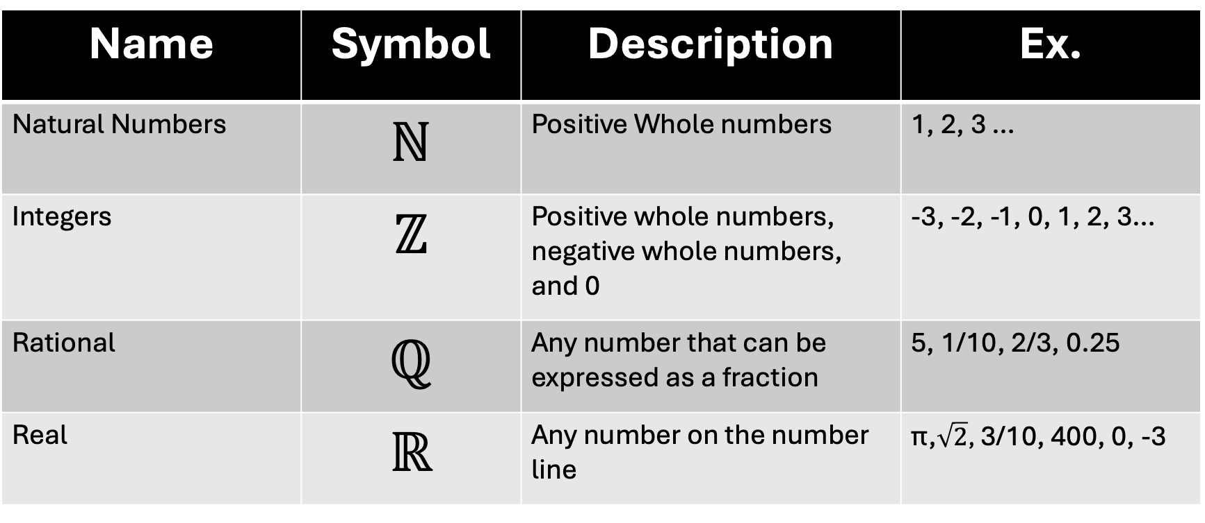
Common sets of numbers
Name | Symbol | Description | Ex.
Natural Numbers | ℕ | Positive Whole numbers | 1, 2, 3 …
Integers | ℤ | Positive whole numbers, negative whole numbers, and 0 | -3, -2, -1, 0, 1, 2, 3…
Rational | ℚ | Any number that can be expressed as a fraction | 5, 1/10, 2/3, 0.25
Real | ℝ | Any number on the number line | π,$\sqrt{2}$, 3/10, 400, 0, -3

Slide 8
Sets don’t have to be numbers
Don’t have to be numbers
Letters = {a, b, c, d, e, f, g, h, i, j, k, l, m, n, o, p, q, r, s, t, u, v, w, x, y, z}
Beatles = {John, Paul, George, Ringo}
Don’t have to be in decimal
bin = {0000, 0001, 0010, 0011, 0100, 0101}

Slide 9

∅ The Empty set (aka null set)
A set with nothing in it
{}
|∅| = 0
Still counts as a thing
∅ is not equal to {∅}
| {∅} | = 1
There’s one thing in this set – the empty set!
Think of it this way
1 empty cardboard box
Cardinality of 0
1 box that contains an empty cardboard box
Cardinality of 1

Slide 10
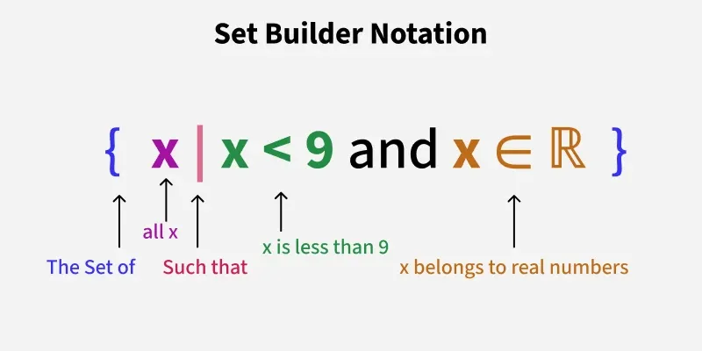

<-- I pick this one (even then things might look a bit inconsistent )
Discrete structures textbook says →
Book of Proof → {2n : n ∈ ℤ} or {n ∈ ℤ : n is even}
This is too many possible ways to phrase the same thing
Pick one and be consistent

Slide 11
So these mean the same thing
E = {−6,−4,−2,0,2,4,6}
E = {n | n ∈ ℤ and |n| < 7}
Notably |n| on a number is still absolute value
Distance from 0 on a number line (always positive)
|set| is cardinality

Slide 12
Practice Name 5 elements from the following sets
A = {n| n%3 equals 0 and n ∈ ℤ}
B = {x| x² < 10 and x ∈ ℤ}
C = {7a + 3b | a, b ∈ ℤ}
D = {p | −2 ≤ p < 7 and p ∈ ℤ}
E = {d| d p ∈ ℤ and |d| < 5}
3, 6, 9, 12, 15, 18 (any multiple of 3)
-3, -2, -1, 0, 1, 2, 3
7 (a = 1, b = 0) 17 (a = 2, b = 1)
189 (a = 23, b = 14)
-2, -1, 0, 1, 2, 3, 4, 5, 6
-2, -1, 0, 1, 2, 3, 4, 5, 6

Slide 13
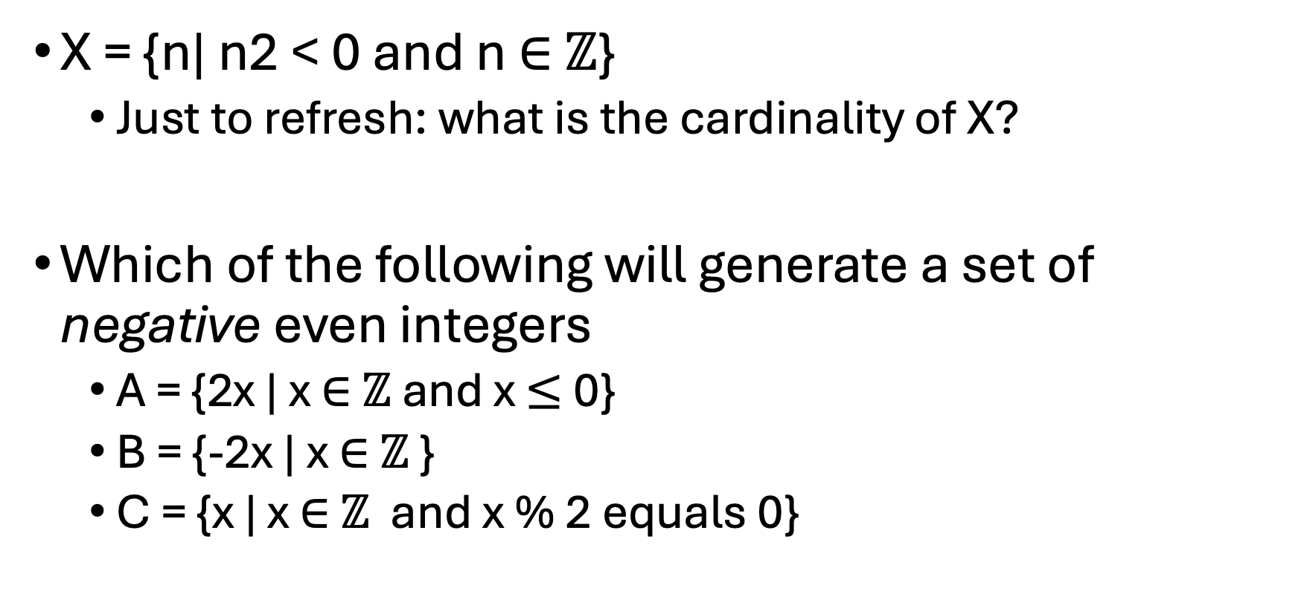
Little more practice…
X = {n| n2 < 0 and n ∈ ℤ}
Just to refresh: what is the cardinality of X?
Which of the following will generate a set of negative even integers
A = {2x | x ∈ ℤ and x $≤$0}
B = {-2x | x ∈ ℤ }
C = {x | x ∈ ℤ and x % 2 equals 0}
∅
0

Slide 14
Some weird properties of our known sets
Sometimes sets are infinite in both directions
ℤ, ℝ, ℚ
No smallest item in this set, no largest
Some are infinite in one direction
ℕ
All positive whole numbers
1 is the SMALLEST item in this set
No largest item in this set

Slide 15
Set Operators
Subsets, union, intersection

Slide 16
Lets say we have a set (called A) of some stuff
A

Slide 17
And we have a set (B) that has no elements in common
A
B
We’d say A and B are disjoint

Slide 18
A contains all the elements of C (and then some
Ex. A = {1, 2, 3, 4} C = {2, 3}
A
C
C ⊂ A C is a subset of A or A is a superset of C

Slide 19
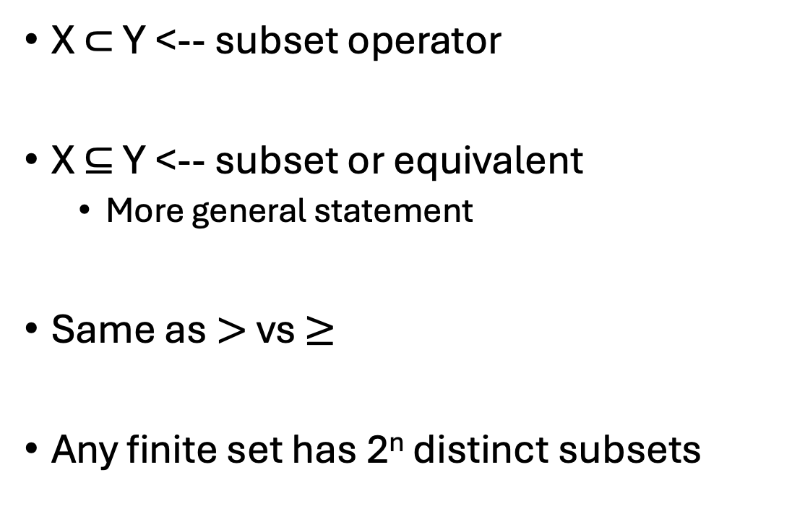
Subset notation:
A
C
C ⊂ A and C ⊆ A
X ⊂ Y <-- subset operator
X ⊆ Y <-- subset or equivalent
More general statement
Same as $>$vs $≥$
Any finite set has 2^{n} distinct subsets
A
C
C ⊆ A
But in this case, A = C

Slide 20
Think of it this way
Start with an empty cardboard box
I put 3 things (a, b, and c) in that box
One at a time
I could have stopped at any time
X = {}
X = {a, b, c}

Slide 21

Or maybe another way?
Lets say I have a box full of stuff
Any thing(s) I can remove from this box can be described as a set
I could remove the piggy bank
X = {piggy bank}
I could remove the piggy bank AND the cactus
Y = {piggy bank, cactus}
OR I could not remove anything
Z = {}
Since that’s always an option ∅ ⊂ Box

Slide 22
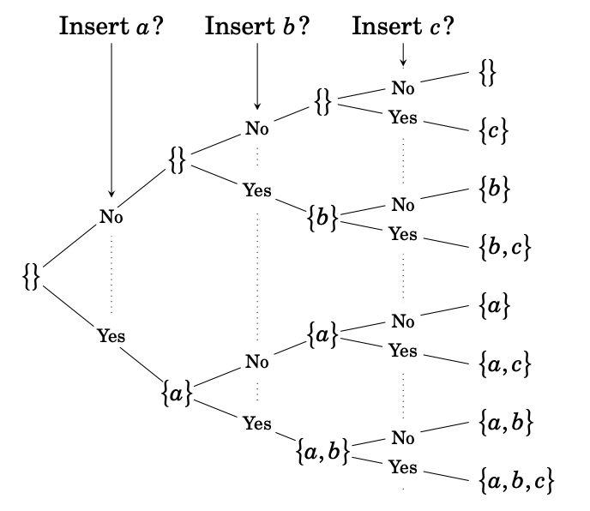

Slide 23
Quantifiers Practice
Suppose that X ⊆ Y and Y ⊆ Z Does this mean that X ⊆ Z ?
How do we translate this given the following propositions?
P(a) = a ∈ Z
R(c) = c ∈ X
∀n ∈ (X ∪ Y ∪ Z), R(n) → P(n)
For all elements in X or Y or Z, if that element is in X then it is in Z
We’ll prove this in a different class

Slide 24
Set Intersection In both A and B
A ∩ B = {x |x ∈ A and x ∈ B}
A = {1, 2, 3, 4}
B = {2, 3, 4, 6, 7, 9}
A ∩ B = {2, 3, 4}
B
A

Slide 25
Set Union In either A or B
A ∪ B = {x | x ∈ A or x ∈ B}
A = {1, 2, 3, 4}
B = {2, 3, 4, 6, 7, 9}
A ∪ B = {1, 2, 3, 4, 6, 7, 9}
B
A
I mix these up so badly too

Slide 26
Complement
A – Everything EXCEPT what is in A
All possible ice cream flavors except vanilla, chocolate, and strawberry
Also sometimes A^{C}
Which is a lot easier for me to type
A
If P is a set of all prime numbers
Name some numbers in P^{C}?

Slide 27
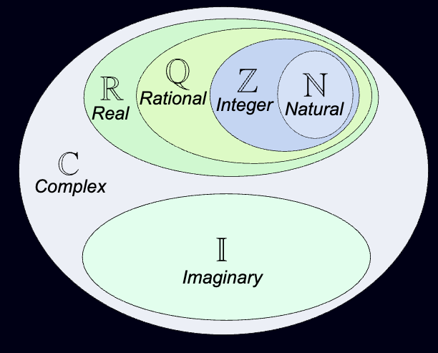
There’s always a bigger set
A = {x| x is even and x ∈ ℤ}
All even integers
A ⊂ ℤ
ℤ is all integers
A is just some of them
A ⊂ ℤ ⊂ ℚ ⊂ ℝ ⊂ All numbers (C) ⊂ All things on earth ⊂ All things
IF A = {x| x is even and x ∈ ℤ}
What is A^{C}?
https://www.mathsisfun.com/sets/number-types.html

Slide 28
It Depends We decide what the context is
A = {all even integers}
If our ‘universe’ is ℤ, then A^{C} is all of the odd integers
If our ‘universe’ is ℝ, then A^{C} is all of the odd integers and any even number with a decimal point

Slide 29
Difference
B
A
Everything in one that isn’t in the other
Order matters in your operators
B − A = {x|x ∈ B and x /∈ A}
B
A
A − B = {x|x ∈ A and x /∈ B}

Slide 30

Symmetric Difference (A or B but not A and B)
A $Δ$ B = {x|x ∈ A and x /∈ B} ∪ {x|x ∈ B and x /∈ A}
B
A

Slide 31
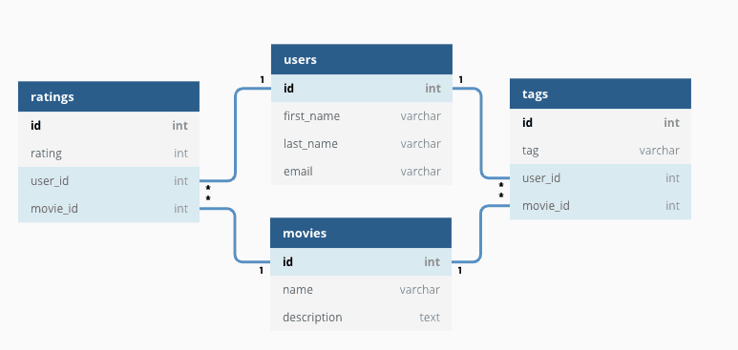
CS applications
One common way to create a database is through structured tables
Ex each user has an ID, a first name, last name, and email
SQL is one language use for accessing data in this structure

Slide 32
SQL allows you to grab relevant data from more than one table at a time
Maybe you want the user’s first name, and the scores of all movies they’d rated
Requires information from Ratings, Users, and Movies in this structure
The word Join allows us to merge and gather relevant data from several tables at once

Slide 33
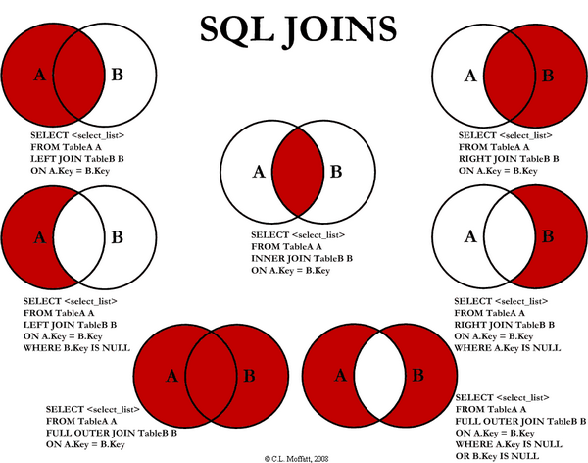
Should look familiar…

Slide 34
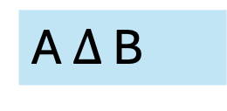
How could we describe these in set theory?
1
6
7
1. 2. 3. 4. 5.
6. 7.
A
5
2
A - B
A U B
A $Δ$ B
3
4
B - A
B
A ∩ B

Slide 35
Personally
I never took a databases course
Here’s what I did have
A knowledge of set theory
A W3 schools tutorial on SQL syntax,
That join graphic
Most day to day operations on relational databases are workable with just that (IMO)

Slide 36
So far in class: New ways to phrase old ideas
All of these set operators are also things we can express with formal logic
Let A and B be sets
How could we prove that A∩B⊆A
All elements in A AND B are a subset of the elements in A

Slide 37
Proving A∩B⊆A
Assumptions:
Let A be a set
Let B be a set
Let S be the set of A∩B (things in A AND B)
Let P(x) = x ∈ A
Let Q(x) = x ∈ B
For any element in S, if P(x) is true and Q(x) is true then P(x) is true
∀x ∈ S, P(x) ∧ Q(x) → P(x) If we want to prove this is True, we need to prove the above statement is a tautology

Slide 38
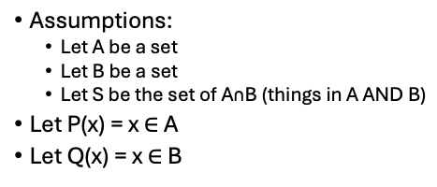
Proof
Lets make a truth table
P(x) | Q(x) | P(x) ∧Q(x) | P(x) ∧Q(x) → P(x)
T | T
T | F
F | T
F | F
T ∧ T = T
T → T = T
P(x) ∧Q(x) → P(x) is a tautology
T ∧ F = F
F → T = T
No matter what elements we’re looking at, (whether it be S, or ℤ or ℝ, anything) This statement holds true
F ∧ T = F
F → F = T
F ∧ F = F
F → F = T
By definition, any element in S would be T ∧ T → T anyway

Slide 39
Maybe something a bit more complicated
We know in logic that ¬(A ∧ B) is equivalent to ¬A ∨ ¬ B)
What about (A ∪ B)^{C} and A^{C} ∩ B^{C} ?
A U B is all the things in A AND B
A ∩ B is all the things in either A OR B
A^{C} is all the things in our universe not in A
Lets do the same thing to check

Slide 40
Are (A ∪ B)^{C} and A^{C} ∩ B^{C} equivalent statements?
Assumptions:
Let A be a set
Let B be a set
Let S be the set of A∩B (things in A AND B) Let T be the set of A U B (A OR B)
Let P(x) = x ∈ A
Let Q(x) = x ∈ B
P(x) | Q(x) | ¬ (P(x) ∧ Q(x)) | ¬ P(x) V ¬Q(x) | Same?
T | T | F | F | Yes
T | F | T | T | Yes
F | T | T | T | Yes
F | F | T | T | Yes
Yes! DeMorgan’s law strikes again

Slide 41
My big hangup with proofs
Why do I care
Seems really obvious – why bother even trying to prove this
It’s true because it’s obviously true
Mostly – you don’t need to prove something this clear
BUT
You can still write a proof for this
You know it needs to be proven (not disproven)
Practicing getting around that “it’s true because it feels right”

Slide 42
So – how do I translate these things properly?
Generalizations are usually a good indicator
“All X are Y”
∀ a (a ∈ X → a ∈ Y)
If an element is in X then that element is in Y
If a shape is a square then it is a rectangle
“No X are Y”
Conditional! X →¬Y
If an element is in X then it is not in y
If a shape is a square, then it is not a circle
Some X are Y
Conditional! ¬(X → ¬Y)
It is not true that if an element is in X, then it is not in Y
Some X are not Y
Conditional! ¬ (X → Y)
It is not true that if anything is a member of X, then it is a member of Y

Slide 43
Sets of sets

Slide 44


Sets of sets
A set can be a group of things
Including other groups of things
Bruins = {Joonas Korpisalo, Viktor Arvidsson, …}
Rangers = {Spencer Martin, Jonathan Quick, …}
All Hockey Teams = { , , …}

Slide 45
Power sets (P or P )
Use any fancy P I can’t find any ”standard”
Given a set X, the power set of X is the set of all possible subsets of X
X = {a, b, c}
P(X) = {∅, {a}, {b}, {c}, {a,b}, {a,c}, {b, c}, {a, b, c} }

Slide 46
Practice Find the cardinality of the following sets
4
A = {3, 9, 12, 22}
B = {n| n%3 equals 0 ∧ n ∈ ℤ ∧ 0 < n < 31}
C = {1, {2, 3,} 4, ∅}
D = A – B
X = P (A)
10
4
{22}
1
16

Slide 47
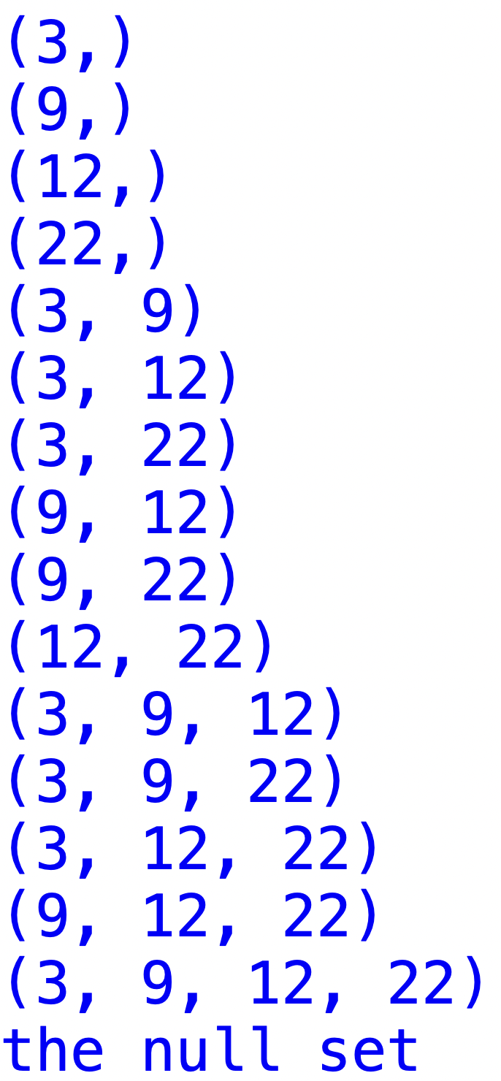
|P (A) | = 16
I won’t test you on this

Slide 48
Cartesian Product
A × B = {(x, y)|∀ x ∈ A and ∀y ∈ B}
(x, y) is an ordered pair – not a set (order matters)
Ex.
A = {Red, Blue, Green}
B = {1, 2, 3}
A x B = {
(Red, 1), (Blue, 1), (Green, 1),
(Red, 2), (Blue, 2), (Green, 2),
(Red, 3), (Blue, 3), (Green, 3),
}

Slide 49

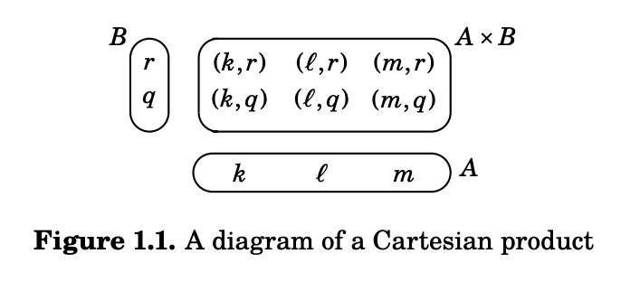
Another way to frame it

Slide 50
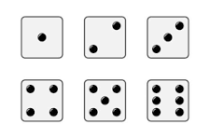
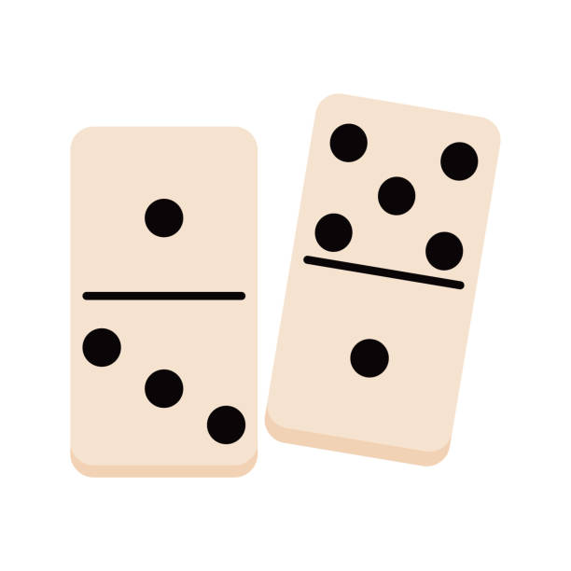
Practice
Dice = set of all dice faces + a blank
I want to find all possible combinations of 2 dice faces to make a set of dominoes
Dominos = D x D
What is |Dominos|?

Slide 51
Plotting cartesian products
Assuming the left item is the x coordinate,
And the right one is the y coordinate…
What would it look like to plot all Dominos on an xy plane?

Slide 52
Speaking more generally
Lets say we have some set with n items in it
A = {x₁, x₂, x₃, …. x_{n}}
We can also use set builder notation with a set like this
B = {y | y ∈ A and y %2 equals 0}

Slide 53
Infinite in different directions
ℕ is a set of positive whole numbers
{1, 2, 3, …}
1 is the smallest number in the set
There is no highest number
This is different from ℤ, ℚ, or ℝ
No highest number
No smallest number

Slide 54
That’s it for sets this week
Lets think about this month

Slide 55
Feedback first
What’s working
What isn’t
Note –
I know getting feedback on homeworks is a priority for you. I’m actively working on this and want the turnaround to be faster generally

Slide 56
Remainder of class: Open Q and A on anything so far
If you’re feeling good – great! An early night for you
Reminder: no stupid questions
Pastry of your choice from standard if you can ask a good-faith stupid question

Slide 57
Mixed Quantifiers?

